Slide 1
Colossians 1 & 2
Christ at the Core
Jonathan Henrichsen

Slide 2
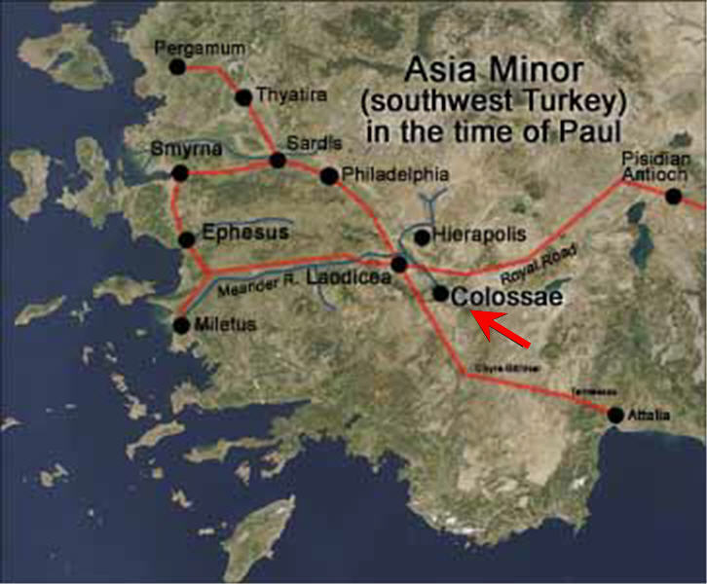
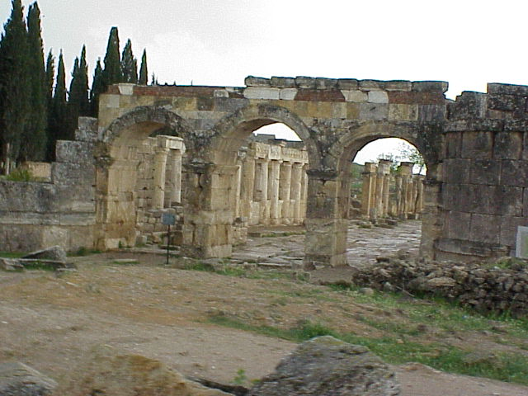
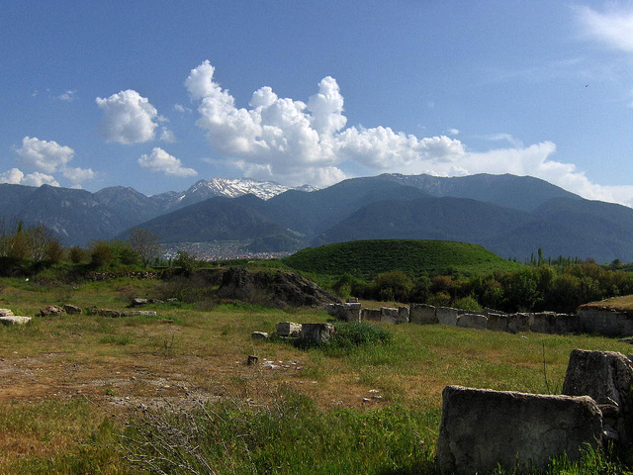
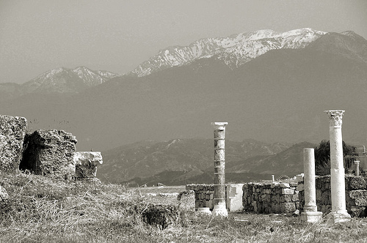
Overview:
Colossae
Timing
Author
Purpose

Slide 3
Portrait of Christ
The Image of the Invisible God1
The Firstborn of All Creation2
All Things Created By, Through & For Him
Before All Things
1 Heb 4:15
2 Phil 2:10-11

Slide 4
Portrait of Christ
In Him, All Things Hold Together
Head of the Body/Church3
Firstborn From the Dead
Preeminent in EVERYTHING4
3 John 14:21
4 Isa 43:7

Slide 5
Portrait of Christ
In Him, All the Fullness of God is Pleased to Dwell
Through Him, We Are Reconciled to Him5
5 Heb 9:22; Rom 8:18-23

Slide 6
Portrait of Christ
Application:
__________6
__________
__________
Romans 11:36
6 Matt 7:22-23

Slide 7
Final Notes on Chapter 1
Reconciliation -
Before:
After:
1:24 - Filling up what’s lacking in Christ’s afflictions?

Slide 8
Colossae False Teaching
Plausible arguments that were nevertheless delusional, v4
Philosophy
Empty deceit
According to human tradition
According to elemental spirits of the world, v8
Questions of food and drink

Slide 9
Colossae False Teaching
Questions of festivals, new moons and Sabbaths, v16
Asceticism (also in v23)
Worship of angels
Visions
Puffed up without reason by sensuous minds, v18
Worldly regulations: do not handle, do not taste, do not touch, v21
According to human precepts and teachings, v22
Promoting self-made religion
Severity to the body, v23

Slide 10
Colossae False Teaching
Conclusions & Parallels:
Based on human wisdom7
Mysticism
Jewish law and traditions
Legalism
7 1 Cor 1:18-25

Slide 11
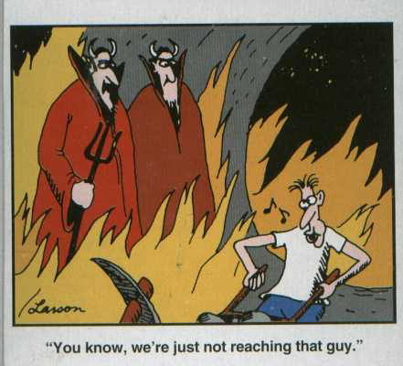
Legalism
What is the appeal of legalism?
______________
______________
______________
______________
______________
______________

Slide 12
False Teaching Today
What are some examples of false teaching you see in the Church today?
______________
______________
______________
______________
______________
______________
______________
______________
______________
______________
______________
______________
______________
______________
2 Cor 4:17-18
Luke 12:5
Matt 12:36

