Slide 1
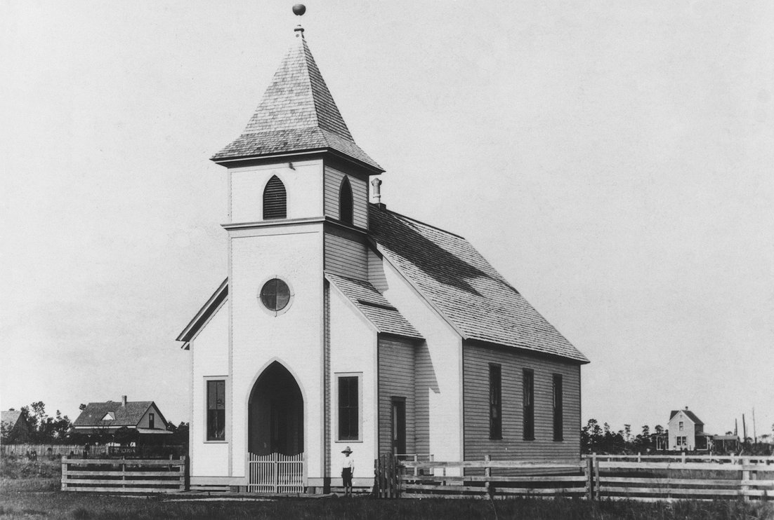
The Essence of New Testament Church

Slide 2
The Essence of New Testament Church
“Christ and His disciples immediately attacked and exposed and denounced error. We are constantly told in our day that we ought not to attack error but simply teach the truth.
This is the method of the coward and trimmer; it was not the method of Christ.”
- Reuben A. Torrey, Evangelist and Founder of Biola University

Slide 3
The Essence of the New Testament Church
ROMANS 12:10
Be devoted to one another in brotherly love. Honor one another above yourselves.
PHILIPPIANS 2:3-4
Do nothing from selfishness or empty conceit, but with humility of mind let each of you regard one another as more important than himself; do not merely look out for your own personal interests, but also for the interests of others.
COLOSSIANS 3:12-14
Therefore, as God’s chosen people, holy and dearly loved, clothe yourselves with compassion, kindness, humility, gentleness and patience. Bear with each other and forgive whatever grievances you may have against one another. Forgive as the Lord forgave you. And over all these virtues put on love, which binds them all together in perfect unity.
Notes:
I want to begin with 3 passages that pinpoint the essence of church in the NT. Note the “one another’s” as I read.

Slide 4
The Essence of New Testament Church
The essence of the New Testament church is RELATIONSHIPS:
The network of GOD-CREATED RELATIONAL CONNECTIONS that believers have with each other.
---
MY CHURCH consists of the believers God has brought into my life who are closer to me than pagan members of my immediate family with whom I have a good relationship.

Slide 5
The Essence of the New Testament Church
God’s purpose for the church in the New Testament:
the spiritual growth of the individual believer.
God’s means for carrying out the church
in the New Testament:
believers biblically building each other up.
God’s agenda for church in the New Testament:
exclusively contained in the New Testament.
Notes:
The most common descriptors of believers in the NT are terms having to do with family. Believers are brothers, co-heirs with Jesus, adopted children of God, who is their Father. This family connection with other believers is accomplished by the indwelling Holy Spirit. This network of God-fashioned relational connections is also called “church” in the NT.
God’s purpose for the “church” in the NT is spiritual growth, the transformation of my mind.
God’s means for doing church is believers building each other up for their good and God’s glory.
God’s agenda for the transformation of each individual believer is found exclusively in the NT. Nothing more is required.

Slide 6
The Essence of the New Testament Church
EXAMPLES OF NEW TESTAMENT RELATIONSHIP TYPES
Mentor / ‘mentoree’
Peer relationships
Relationships between believing family members
Employer / employee relationships
Notes:
Next, to briefly flesh out what NT church looked like, let’s briefly look at some of the types of relationships found in the NT, & then the value and importance of inter-believer relationships.
B. The types and value of relationships in the NT church.
a) In the NT you find various types of relationships, as you can see.
Mentor/mentoree relationships are the most important type of relationship found in the NT. Jesus and his 12 disciples, Paul and Timothy, are examples of this type of relationship. And for me personally, mentors have had a huge role in my life, so I am going to share my mentor experience with the hope that it will help you appreciate the importance mentors play in the individual believer’s growth.
Early in my childhood, there were 3-4 individuals who took my parents under their wing & mentored them, discipled them. This investment produced profound, lifelong changes in my Mom. One change that continued during my growing up was that a couple of times a year we would have people in discipling ministry stay in our home the entire time I was there. These folks were different than other Christians I came across. Their character, conduct, and spiritual maturity greatly impressed me.
Fast forward to my late 20s. God brought a man into my life like the men that stayed in our home. In my 1st prolonged conversation with Harvey, he asked me who, on judgment day, knew me well enough to stand beside me and give an account to God for my soul. I knew lots of Christians, and I knew none of them really knew me well enough to be able/willing to do that. When I answered “no one,” Harvey leaned toward me, poked his index finger in my chest, and said, “I’d be willing to do that.”
Well, game over. I spent the next 10 years getting help spiritually from Harvey. He profoundly changed the course and direction of my life. My being at this conference, all the wonderful relationships I have with you all in GA & AL, are indirectly the result of Harvey’s investment.
The value of ‘inter-believer’ relationships:
(I will come back to this in a minute, but realize) All God desires to accomplish in our lives, in terms of spiritual growth, comes about through the relationships He brings us into with other believers.
Eph. 4:11-13 (Lincoln)
¹¹ And it was he who gave the apostles, the prophets, the evangelists, the pastors and teachers
¹² for bringing the saints to completion, for the work of service, for the building up of the body of Christ ¹³ until we all attain to the unity of the faith and of the knowledge of the Son of God, to the mature person, to the measure of the stature of the fullness of Christ…

Slide 7
The Essence of the New Testament Church
HOW RELATIONSHIPS CAUSE SPIRITUAL GROWTH
Eph. 4:11-13 “And it was he who gave the apostles, the prophets, the evangelists, the pastors and teachers to prepare God’s people for works of service, so that the body of Christ may be built up until we all attain to the unity of the faith and of the knowledge of the Son of God, to the mature person, to the measure of the stature of the fullness of Christ…”
Relationships provide opportunities to:
Learn by example
Use spiritual gifts to benefit others
Encourage and comfort
Notes:
To illustrate, here are a few of the ways God uses our relationships with other believers to spur our spiritual growth:
a) (First, relationships give me the opportunity to) learn by example. Walt has said, “example is not a way to teach, it is the only way to teach.”
As a result of the time Timothy spent with Paul, Paul tells Timothy in 2 Tim. 3:10-11,—“You, however, know all about my teaching, my way of life, my purpose, faith, patience, love, endurance, persecutions, sufferings…” Very few people had the opportunity Timothy had to learn from Paul in this manner.
b) (Also, relationships provide an) Opportunity to exercise my spiritual gifts: As Paul sets forth in Eph. 4:11-13, it is through the exercise of gifts given by Jesus that we become “mature,” that we “attain to the measure of Christ’s full stature.” As Jesus and Paul demonstrate, this is accomplished in the context of a discipler/disciplee relationship.
c) Relationships are the context in which comfort & encouragement are received & dispensed:

Slide 8
The 21st-Century Church
THE ORGANIZATION’S ORIGINS
The essence of the 21st-century church is ORGANIZATION:
the planned, coordinated and purposeful action of people, working collectively, to achieve a common goal, whether it is a business, nation, army or church.
Notes:
(Let me begin with a definition of organization:) An organization, whether it is a business, nation, army, or church, is simply the planned, coordinated and purposeful action of people, working collectively, to achieve a common goal.

Slide 9
The 21st-Century Church
THE ORGANIZATION’S ORIGINS
Conundrums Confronting 1st-century Christianity:
HERESY
DISSENSION IN THE RANKS
Anti-Semitism and the felt need for an authority structure in order to be able to exert control, led early Christians to conclude that they had supplanted Israel as God’s chosen people; that they were the ‘new Israel’.
Notes:
Early in its history, Christendom, chose to carry out “church” using an organizational framework, despite the complete absence of any command or provision of organizational structure in the NT. Why did 1st century Christians make this choice?
As the NT was completed and the apostles departed the scene, Christendom continued to face the same 2 problems the apostles battled: heresy and dissention in the ranks. And further complicating their predicament, these early Christians found the mechanisms present in the NT for dealing with heresy and dissension anemic and ineffective. What was it to do? How to solve these seemingly intractable problems?
Early Christendom’s solution was ingenious. Because of Jewish persecution, early Christians were anti-Semitic. And in their anti-Semitic frame of mind, they discovered that the authority structure and control they felt they desperately needed to rein in heresy was available in the Jewish OT, the nation Israel.
Their anti-Semitism and the felt need for an authority structure and control led early Christians to erroneously conclude Christianity had supplanted Israel as God’s chosen people; they were the ‘new Israel’.

Slide 10
The 21st-Century Church
THE ORGANIZATION’S IMPACT
What impact would the addition of an organizational structure have on doing what God commanded in the New Testament?
Would the insertion of an organizational structure into what God had provided help or harm spiritual growth?
Notes:
The question no one asked at the time in the 1st century, but that seems obvious to ask in retrospect,
is what impact would adding organizational structure have on doing what God commanded in the NT?
Would the addition of organizational structure help or harm spiritual growth?

Slide 11
The Essence of the New Testament Church
A BIBLICAL MODEL
Everything necessary for executing a Biblical model of the New Testament church can be found in the New Testament:
Commands dictating how believers treat each other, commands requiring leaders to model and teach, and commands requiring believers to have leaders
Special gift(s) from the Holy Spirit for every believer enabling them to serve other believers
A Holy Spirit-imbued worldview
Notes:
All we need to grow spiritually was provided by God in the NT. This includes:
1. commands dictating how they treat each other.
2. commands requiring leaders to model and teach, and commands for the individual to have leader(s).
3. special endowment(s) by the Holy Spirit for every believer, enabling them to serve other believers.
4. Holy Spirit imbued common worldview.

Slide 12
The New Testament vs. 21st-Century Church
Anything the organization adds is at best unnecessary, including:
An authority structure to accomplish organizational goals.
A chain of command to coercively create, measure and control, including rules with punitive consequences for those who fail to comply.
Clearly defined membership.
Ownership of assets.
Notes:
I said earlier that all we need to grow spiritually was provided by God in the NT. If it is true that all I need to grow is provided in the NT, then why superimpose, in the absence of any NT command or example?
If all that is needed for spiritual growth is found in the NT, than at a minimum the resources associated with an organizational structure are unnecessary, such as:
1. Authority structure to dictate/prescribe organizational goals.
2. The ability to create, measure and control, with coercive enforcement mechanisms.
3. clearly defined membership, based in confessions creeds, doctrinal statements.
4. Ownership of assets.
ADD TO NOTES: Rules that allow one person to effectively control another are inimical to the type of loving, serving, intimate relationships the NT envisages.

Slide 13
Important Biblical Worldview Components addressing motivation and how we are to relate to each other
Every believer has a UNIQUE, GOD-GIVEN PURPOSE | Eph. 2:10 “For we are His workmanship, created in Christ Jesus for good works, which God prepared beforehand so that we would walk in them.”
ACCOUNTABILITY on Judgment Day will be individual | 2 Cor. 5:10 “For we must all appear before the judgment seat of Christ, so that each one may be recompensed for his deeds in the body, according to what he has done, whether good or bad.”
No one knows better than the individual believer GOD’S WILL for his life | Col. 1:11-12 “…we have not stopped praying for you and asking God to fill you with the knowledge of his will through all spiritual wisdom and understanding. And we pray this in order that you may live a life worthy of the Lord and may please him in every way…”
The only New Testament basis for one believer relating to another is as a SERVANT | Phil. 2:3-4 “Do nothing from selfishness or empty conceit, but with humility of mind regard one another as more important than yourselves; do not look out for your own personal interests, but for the interests of others.”
Notes:
D. Principles that undergird the functioning of the NT church. As you read the NT, these principles are the milieu in which the NT church operates:
a. God is preparing each of us, individually/uniquely, for an eternity with him.
Each of us must try to understand & pursue God’s unique purpose for him while here on earth. Your gifts and abilities, resources, circumstances, and especially relationships, are the ‘training program’ God has designed specifically for you.
Eph. 2:10 “For we are His workmanship, created in Christ Jesus for good works, which God prepared beforehand so that we would walk in them.”
[God not only predestined you from before the foundation of the world, He also predestined what He had for you to do to glorify Him.]
b. Accountability on judgment day will be individual, not corporate. “People are standing in line to play poker with your chips, but God will hold you, & you alone, accountable for how your chips are played.” Realize you have incredible incentives, both positive and negative, to live out your life on earth in a particular way. You will spend eternity living with the consequences of the choices you make here.
2 Cor. 5:10 “ For we must all appear before the judgment seat of Christ, so that each one may be recompensed for his deeds in the body, according to what he has done, whether good or bad.”
c. No one else can know God’s plan & purpose for my life better than I do.
You may have varying degrees of confidence you know what God wants you to do, but you do not know what God wants someone else to do.
Col. 1:11-12 “…we have not stopped praying for you and asking God to fill you with the knowledge of his will through all spiritual wisdom and understanding. And we pray this in order that you may live a life worthy of the Lord and may please him in every way…
d. Each of us is best served, in our relationships with each other, to have the goal of helping each other become all the other person believes God wants him to be—bc no one knows better what that is than the individual.
Phil. 2:3-4 “Do nothing from selfishness or empty conceit, but with humility of mind regard one another as more important than yourselves; do not look out for your own personal interests, but for the interests of others.”

Slide 14
The New Testament vs. 21st-Century Church
WHAT I’M NOT SAYING:
“Relationship development cannot take place in the 21st-century church organization.”
Notes:
What I am not saying: “Relationship development cannot take place in the church organization.”
What I want to convey is that it is the fundamental nature of organizations that make doing NT church difficult. It is like using a white crayon to darken the ovals on an ACT test. It is the wrong resource for the job.
Weeds can grow in the cracks in a sidewalk, but sidewalks are not where people usually choose to plant gardens.
I had a friend ask me while he was helping me prepare this talk, “why are you beating up the church organization? Can’t you find something more positive to do with your time?”
My response was, “suppose you are selling your car, and it has a bad transmission; do you tell the prospective buyer?”
If you would tell them about the bad transmission, why wouldn’t you tell them if there are forces opposing obeying the NT in the church organization?
Living the Christian life in relationship with other believers is double tough. Why deliberately increase the degree of difficulty when you don’t have to, all other things being equal?

Slide 15
The New Testament vs. 21st-Century Church
The 21st-century church organization is an inhospitable environment in which to live out the New Testament church. WHY?
Pursuit of organizational goals trumps the individual’s pursuit of what he believes is God’s will for his life
Organizational efforts to create and measure, to control
Organizational appetite for assets
Organization leaders vs. the individual believer’s leader(s)
‘Acquaintance-ship’ vs. relationship
Notes:
What, If any, added value does organizational structure offer?
Some reasons why the 21st century church is inherently a non-nurturing, inhospitable environment in which to try to do NT church.
As the definition I shared earlier indicates, organizations are created with a purpose(s), to accomplish something. But in order for an organization to accomplish its goals, the leadership of the organization has to control what the individuals in the organization do. There is nothing inherently wrong with this. But if it is true that God communicates individually His purpose to each believer, then problems arise in at least 2 areas: 1) when the organization prioritizes its goals over God’s plan for the individual believer, and 2) when the organization purports to know God’s plan for the individual believer. Anytime the organization does this, it has erred biblically. It is using people, not serving them.
(Bruce leading Bible study in church, James being told he shouldn’t go to Central America)
b. The work of God in a person’s life—becoming more like Jesus, love, humility, integrity—cannot be created, measured, or controlled. Creating, measuring, controlling are part of the organization’s DNA. Attempts to reduce the unmeasurable changes God makes in my life to a database shifts the focus away from what God values.
(Harvey attempting to reduce the help & counsel to a chart. Puts pressure on him to change what he thinks God wants him to do as he relates to someone, in order to make it fit in a box.)
c. Organizations, churches included, have insatiable appetites for temporal resources. This appetite is like the pull of gravity, constantly drawing the focus of the individuals operating in the organization away from the eternal, to the temporal. Stuff, not people/relationships, becomes the emphasis.
d. If no one knows better than the individual believer God’s will for his life, then church organizations have no biblical basis or authority to determine who your spiritual leaders are. Like the other choices you make, you will give an account for who you follow.
(David’s situation with his friend)
e. Church organizations encourage believers to think that ‘acquaintanceship’ = relationship, that organizational affiliation will somehow satisfy all the NT has in mind regarding relationships.
The reason we are inclined to go along with the organization in this area, that we are prone to settle for ‘acquaintanceships’ is obvious; being involved in others’ lives in a meaningful way is painful & costly.

Slide 16
The New Testament vs. 21st-Century Church
WHAT I AM SAYING:
THE NEW TESTAMENT CHURCH = THE BELIEVERS GOD HAS BROUGHT INTO YOUR LIFE
Relate to the organization on your terms
Don’t become emotionally entangled in the organization
Help others become all they believe God wants
them to become
Notes:
Suggestions for doing NT church in a 21st century church culture.
a) I would encourage you to conceptualize church as the network of relationships God has given you with other believers; these relationships are your church.
You may have relationships with believers in the organization you are affiliated with, but let the relationships determine they are part of your church, not the organization.
Let the NT define “church” for you, not institutional Christianity.
b) Finally, relate to the organization on your terms, as God leads & directs you in His plan for your life, not on the organization’s terms.
Because church organizations attract people who have some spiritual interest, they can be great fishing ponds for developing relationships, for evangelizing and equipping.
So in the time you spend in the organization, make relationships the priority.
c) Don’t allow yourself to become emotionally entangled in the organization.
d) As you do discipleship, in your family, with friends, with those God brings into your life, endeavor to help them become all they believe God wants them to become.
Luke 16:9, “Use worldly wealth to make friends for yourself, so that when it is gone they may welcome you into eternal dwellings.”

